Slide 1



Report
View in Power BI
Last data refresh:
2023/09/06 23:07:24 UTC
Downloaded at:
2023/09/06 23:18:32 UTC

Slide 2
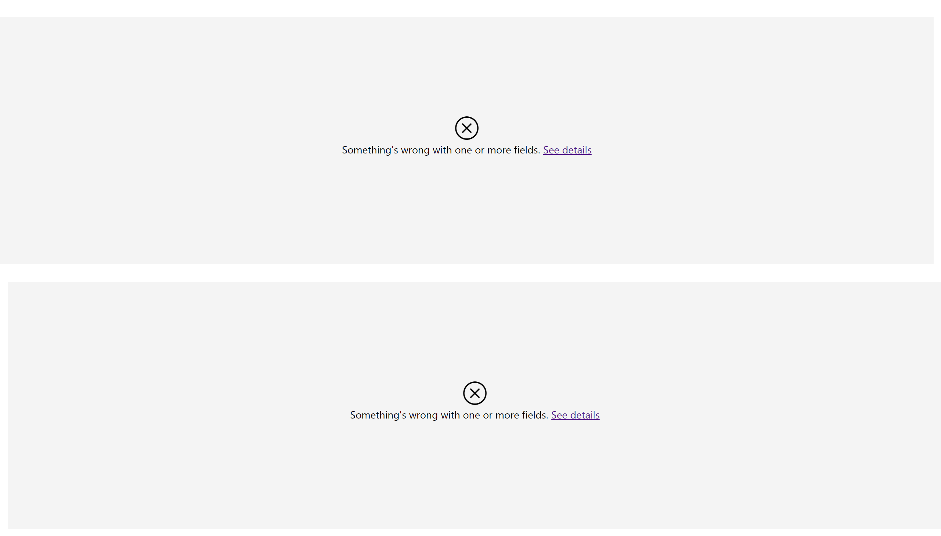
Number of Claim
Notes:
Number of claims per state
No alt text provided
Number of claims
No alt text provided

Slide 3
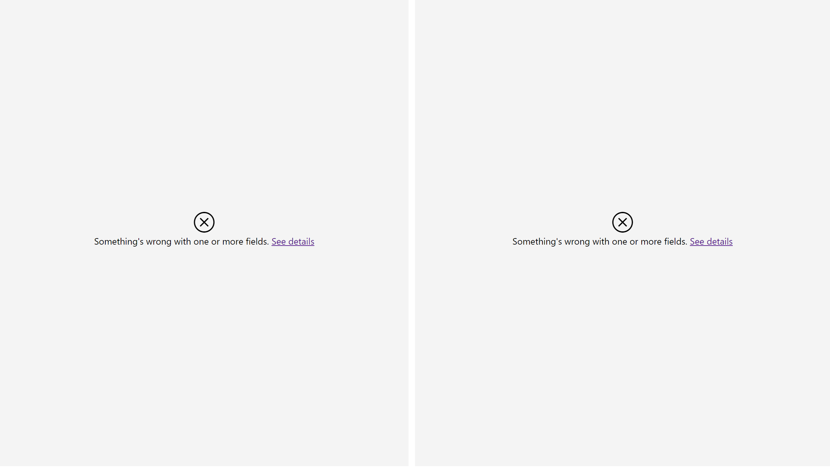
Incident type
Notes:
Incident type
No alt text provided
Value of Claims by Incident type
No alt text provided

Slide 4
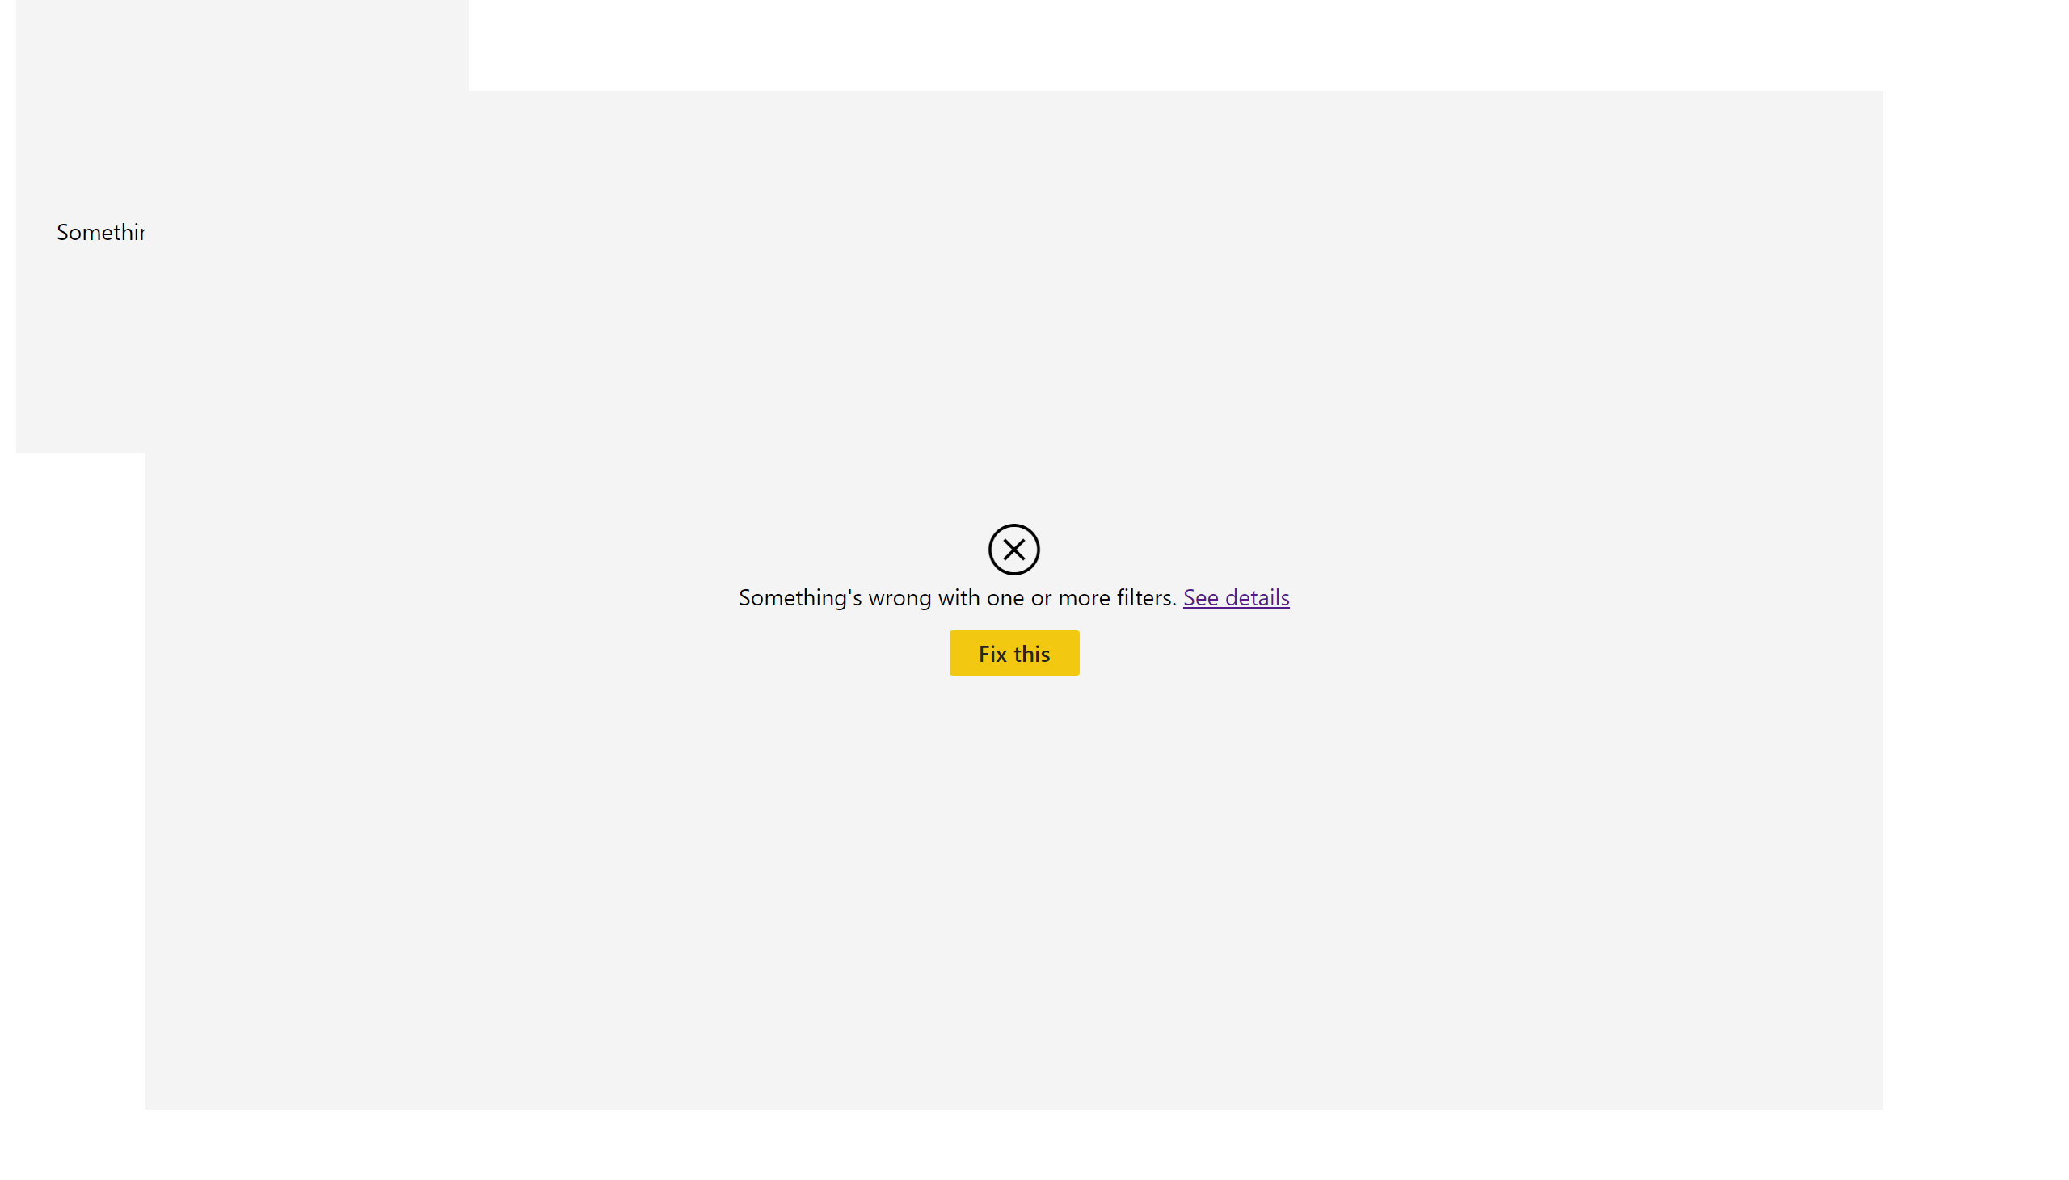
Page 1
Notes:
tableEx
No alt text provided
pieChart
No alt text provided

Slide 5
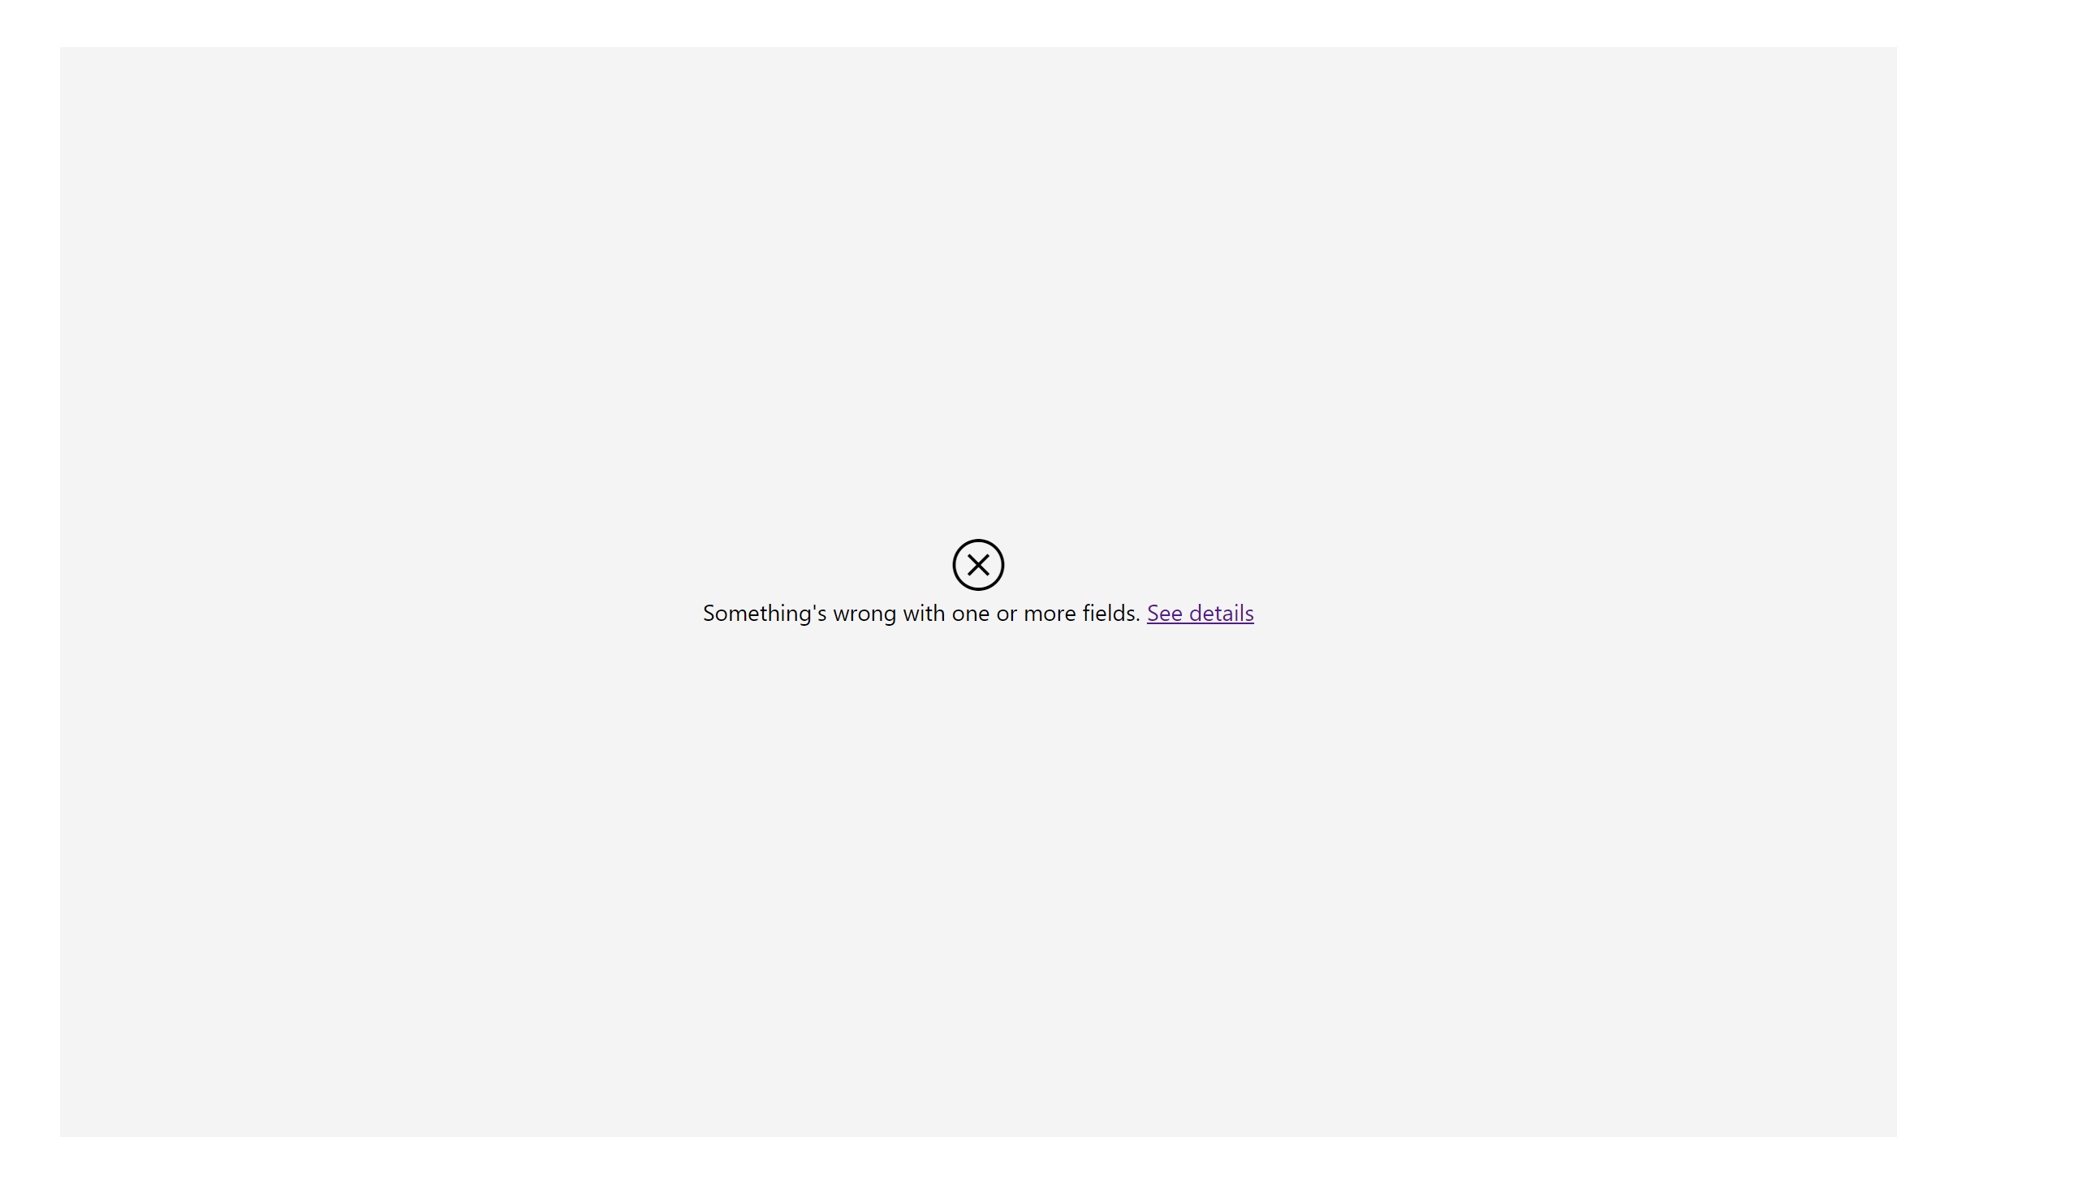
Page 2
Notes:
clusteredColumnChart
No alt text provided

Slide 6
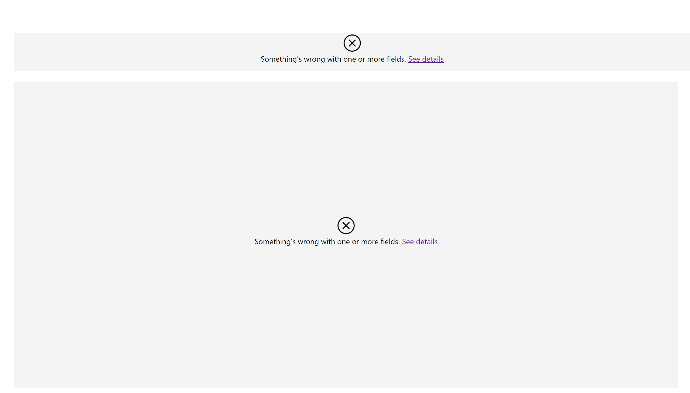
Page 3
Notes:
multiRowCard
No alt text provided
clusteredColumnChart
No alt text provided

Slide 7
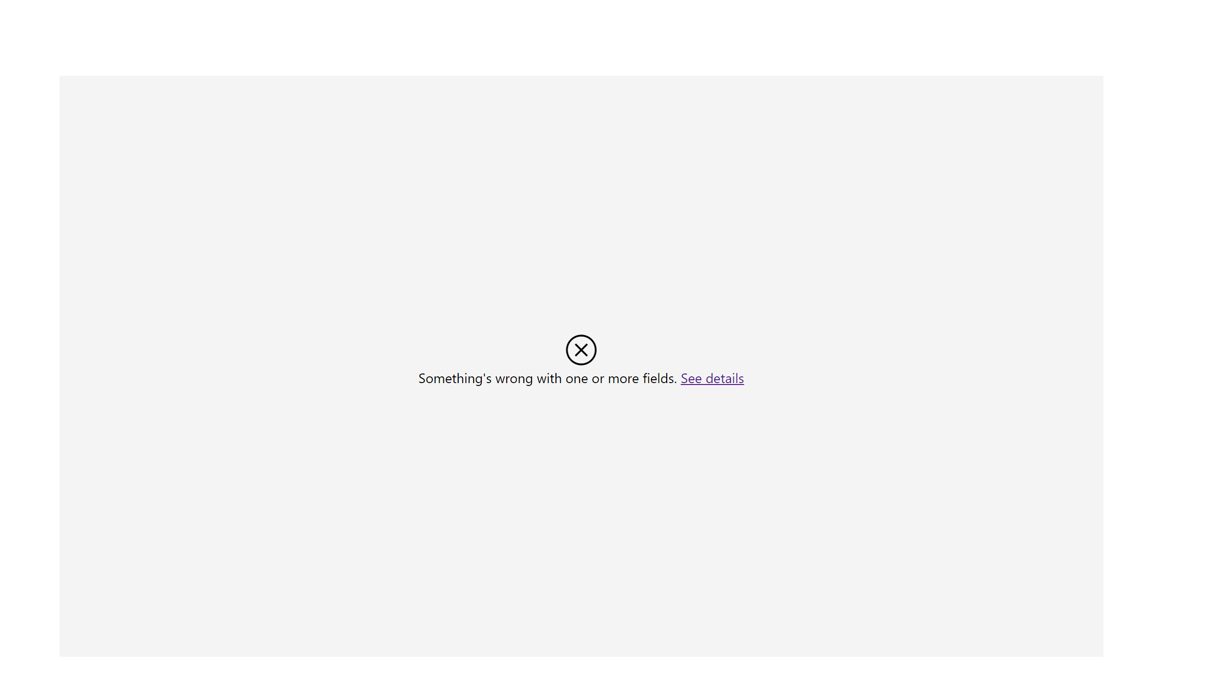
Page 4
Notes:
pieChart
No alt text provided

Slide 8
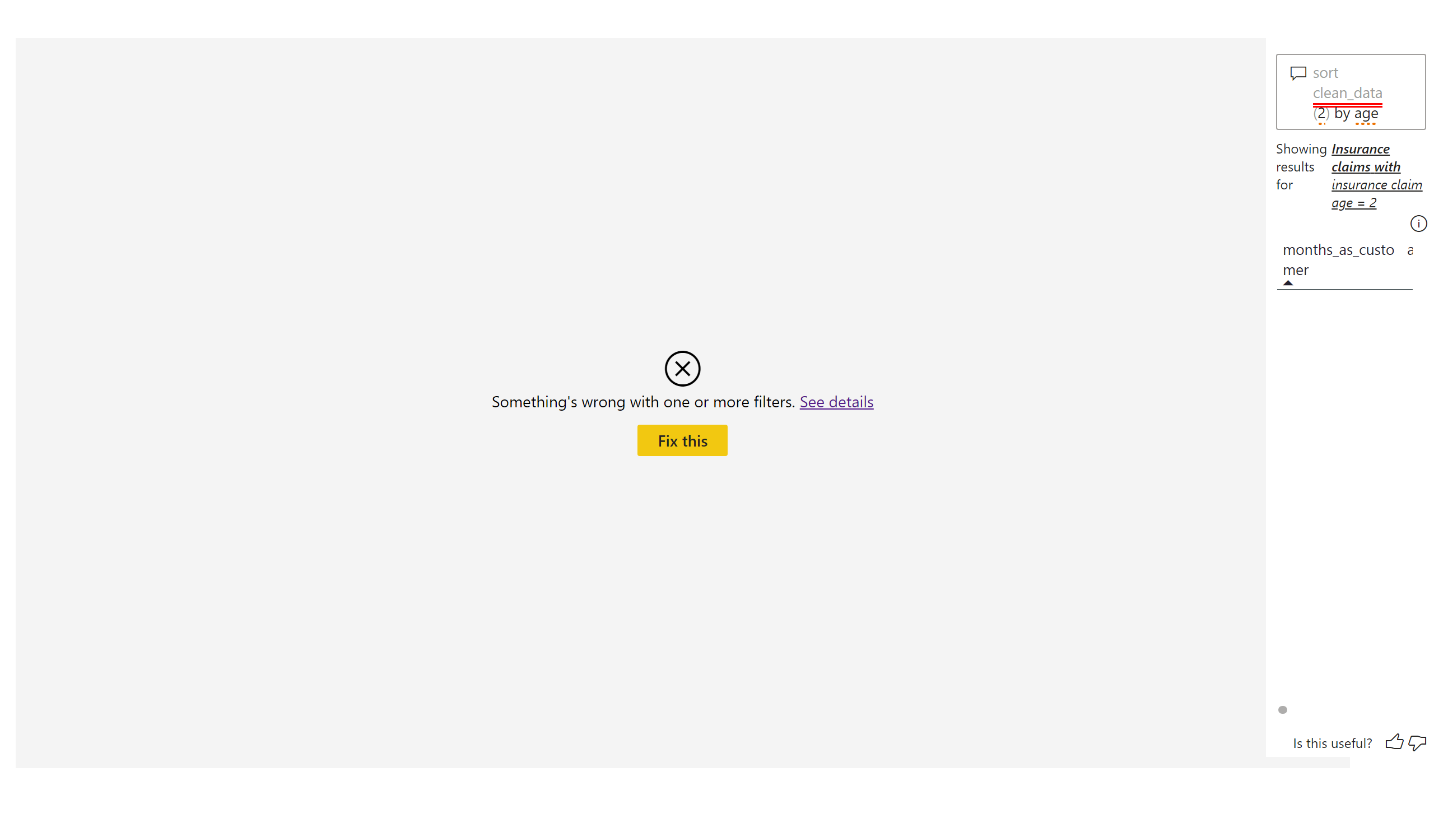
Page 5
Notes:
pieChart
No alt text provided
qnaVisual
No alt text provided

Slide 9
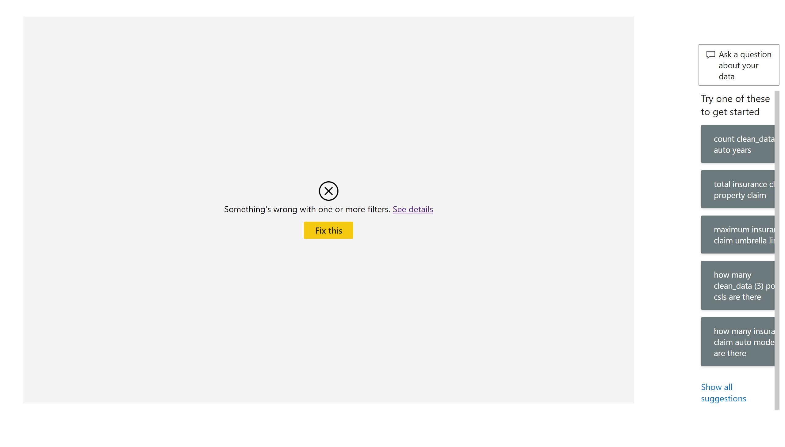
Page 6
Notes:
clusteredColumnChart
No alt text provided
qnaVisual
No alt text provided

Slide 10
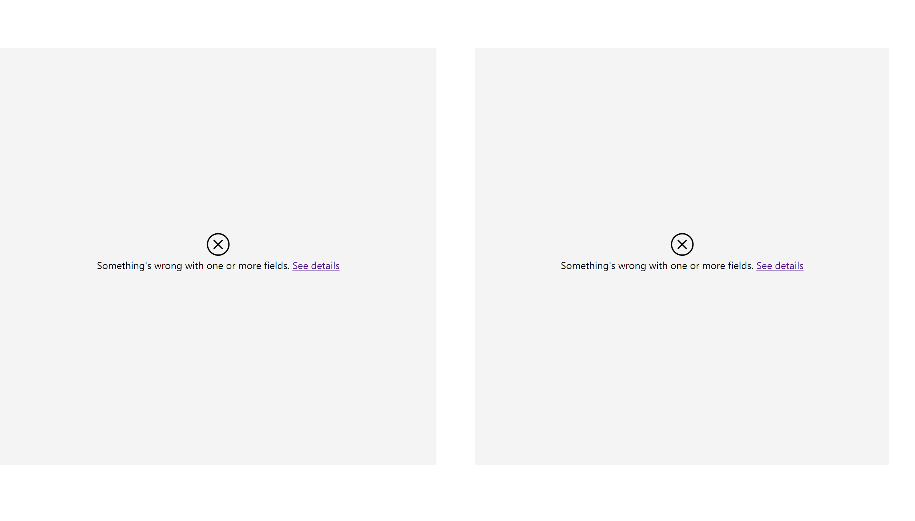
Page 7
Notes:
pieChart
No alt text provided
pieChart
No alt text provided

Slide 11
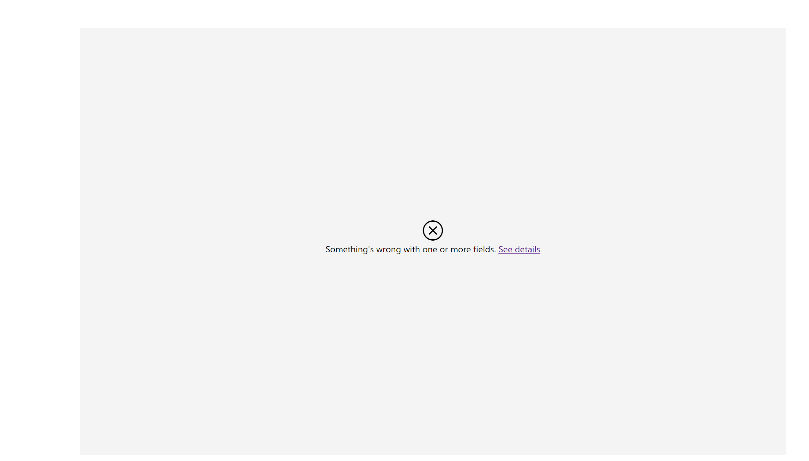
Page 8
Notes:
clusteredColumnChart
No alt text provided

Slide 12
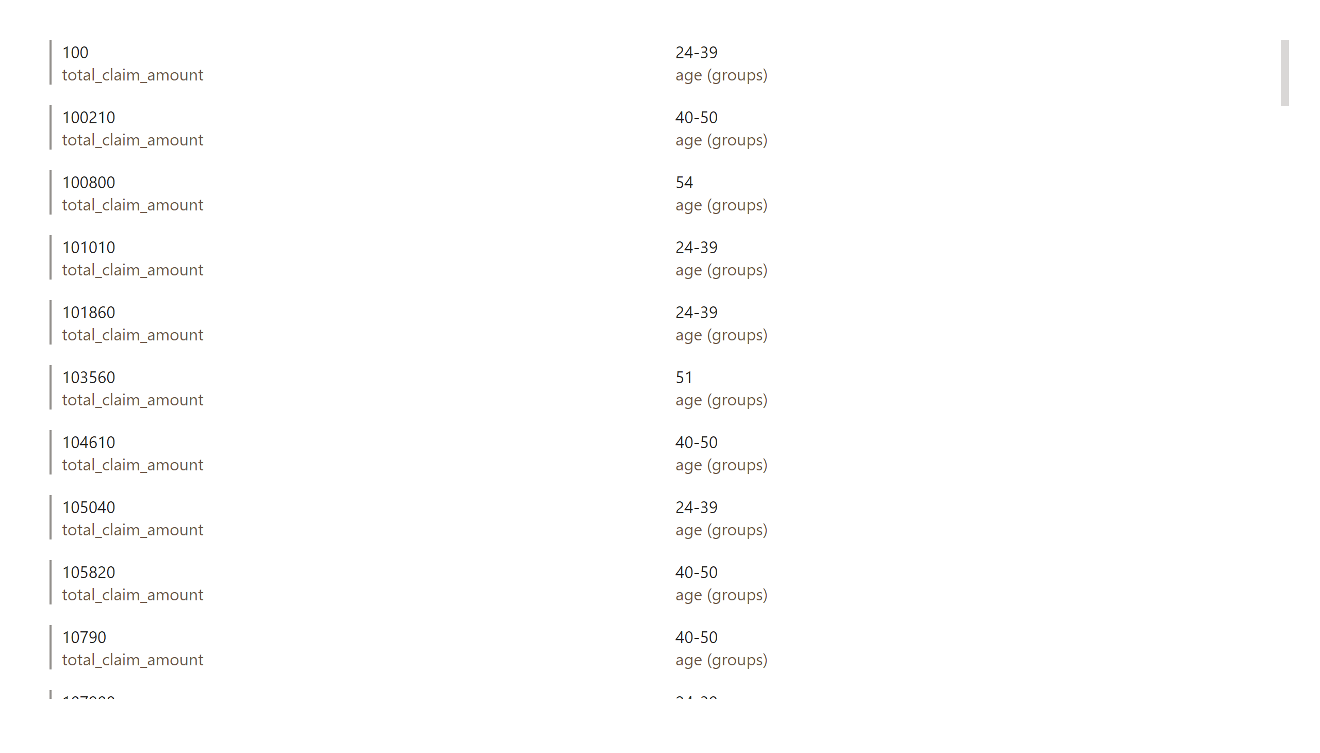
Page 9
Notes:
multiRowCard
No alt text provided

Slide 13
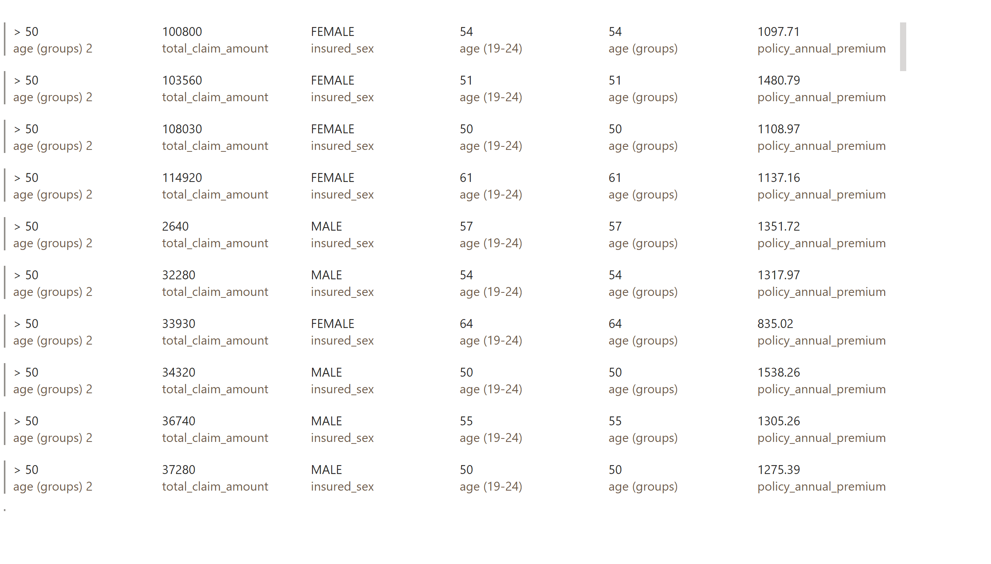
Page 10
Notes:
multiRowCard
No alt text provided

